Slide 1

MbAppE
Kilian Tiziano le Creuer, Matteo Fusconi, Lorenzo Cassano, Jacopo D’Abramo
Notes:
Scelta del linguaggio
Struttura dell’algoritmo → minmax con alphabeta pruning, aima
Euristica
Risultati = profondità ottenuta

Slide 2
Programming Language: Python 3
PROS
Good for Machine Learning
Easy to write
CONS
Inefficency (slowness)

Slide 3
Algorithm Structure
Written on top of AIMA Library
MINMAX with ALPHA BETA pruning depth limited with heuristics
Good algorithm for 1vs1 games
Maximum depth reached: 4

Slide 4
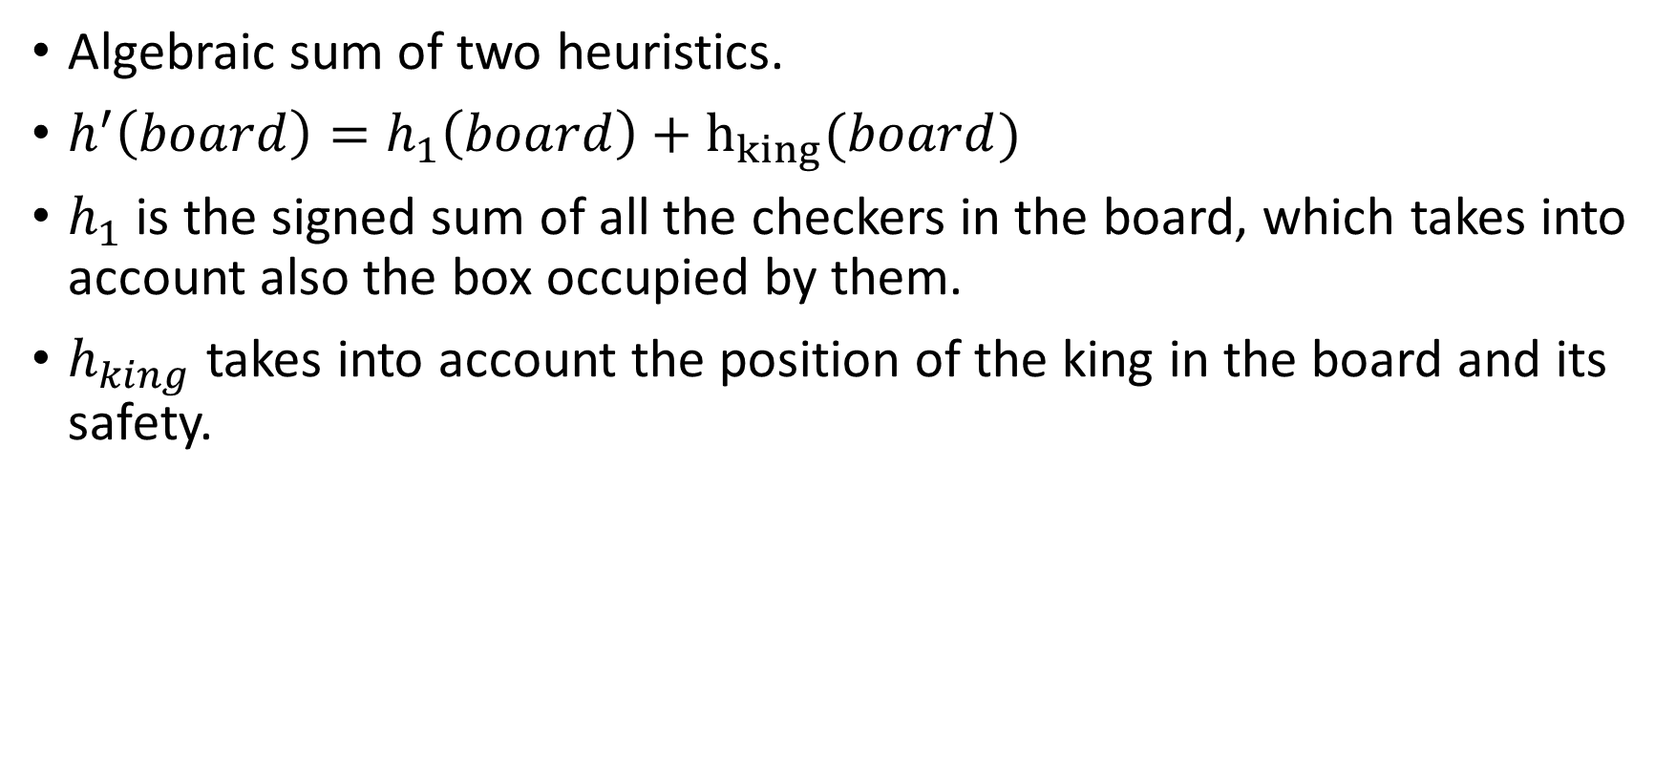
Heuristics
Algebraic sum of two heuristics.
$h^{′}\left(board\right)=h_{1}\left(board\right)+h_{king}(board)$
$h_{1}$ is the signed sum of all the checkers in the board, which takes into account also the box occupied by them.
$h_{king}$ takes into account the position of the king in the board and its safety.

Slide 5
Conclusions
Problem with depth:
Inefficency of code.
Time constraint:
Using a depth first-based algorithm makes it difficult to fulfill time constraints on the move.

